Slide 1


CAR PRICE PREDICTION
INDER DEV SINGH

Slide 2
Title and Content
Introduction
Import Libraries and Dataset
Cleaning The Data
Preparing The Data & Importing The Model
Fitting The Models & check the errors
Import Joblib
Flask
Result

Slide 3
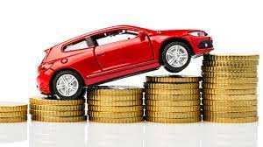
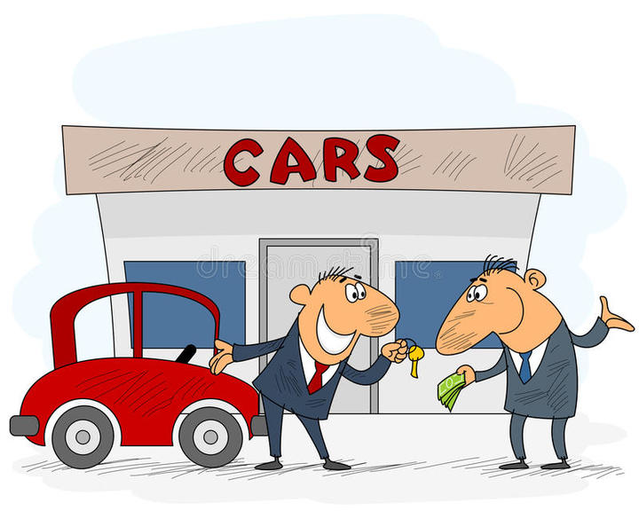
INTRODUCTION
A Machine Learning Project that uses Random Forest Regressor model to predict used cars price based on some attributes such as Fuel Type, Engine Tpye, Engine Size etc.

Slide 4
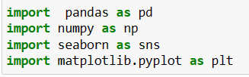
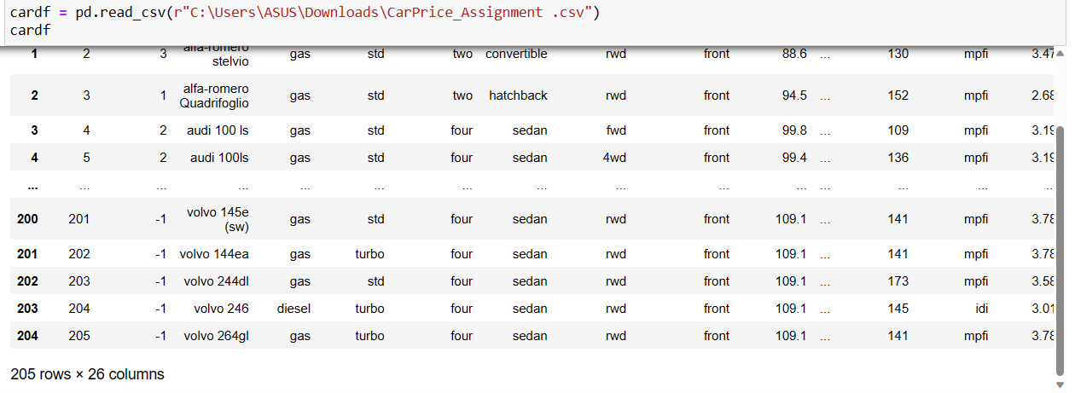
Import Libraries and Dataset
Pandas
Numpy
Seaborn
Matplotlib
Class |  | Group B
Class 1 | 82
Class 2 | 76 | 88
Class 3 | 84 | 90
Import DataSet:-

Slide 5




Cleaning The Data
Data cleaning is the process of fixing or removing incorrect, corrupted, incorrectly formatted, duplicate, or incomplete data within a dataset.
DataFrame. replace() function is used to replace values in column (one value with another value on all columns). This method takes to_replace, value, inplace, limit, regex and method as parameters and returns a new DataFrameThird bullet point here.
Null() is the method that returns true if the value is null and false otherwise.

Slide 6
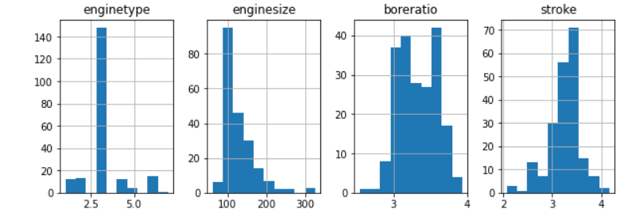
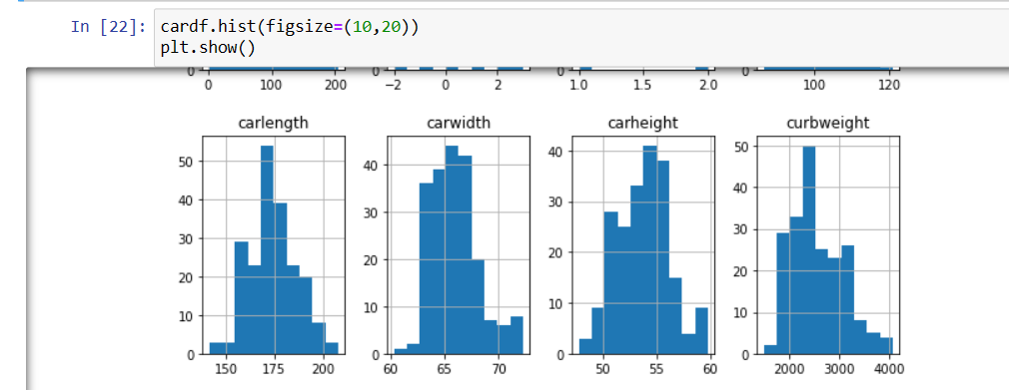
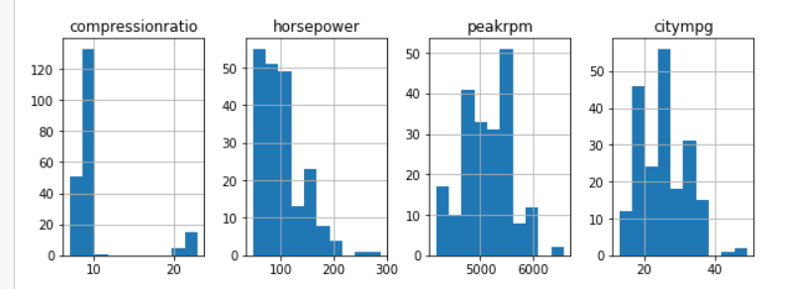
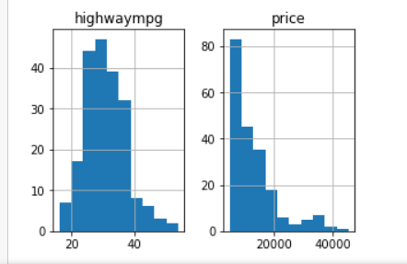
Graph
Graphs in Python can be plotted by using the Matplotlib library. Matplotlib library is mainly used for graph plotting. You need to install matplotlib before using it to plot graphs. Matplotlib is used to draw a simple line, bargraphs, histograms and piecharts.

Slide 7
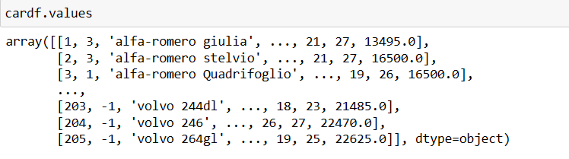
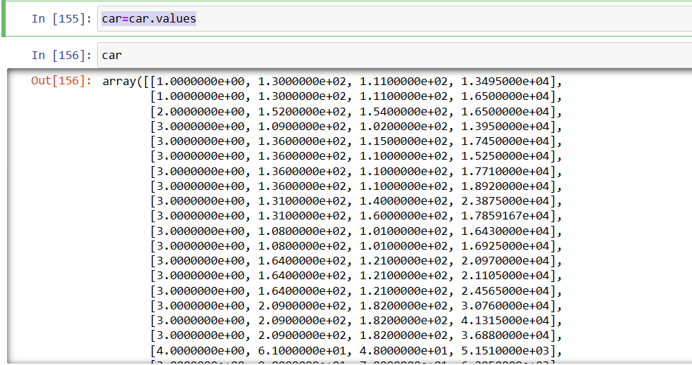
COMPARE BETWEEN RAW DATA V/S AFTER CLEANING

Slide 8
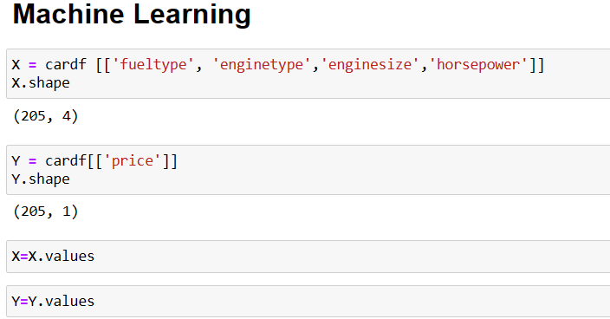
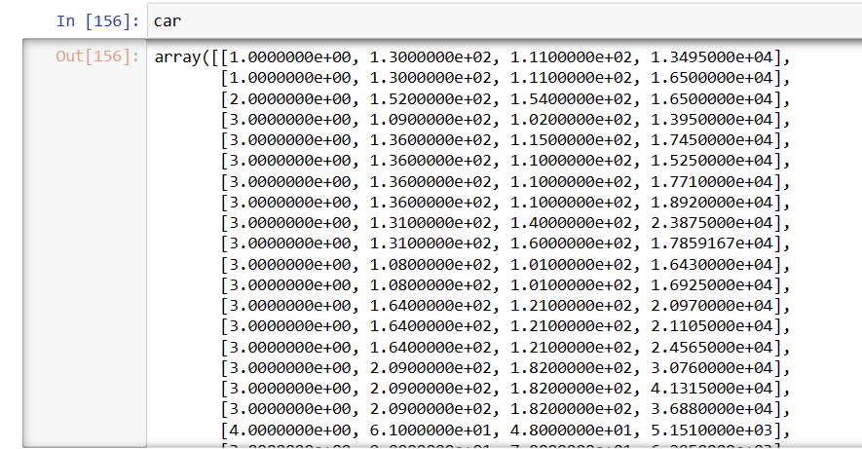
Preparing The Data & Importing The Model
Prepared Data
Preparing data for machine learning involves transforming raw data into a format that can be used by machine learning algorithms. This process includes selecting relevant features, engineering new features, and splitting the data into training and testing sets. Feature selection is important to prevent overfitting, while feature engineering can improve the model's performance. Data splitting is crucial to evaluate the model's performance on unseen data. Pandas provides a range of functions to help with these tasks, including 'iloc' for selecting specific columns, 'apply' for creating new features, and 'train_test_split' for splitting the data. Overall, preparing the data for machine learning is a crucial step in building accurate and reliable models

Slide 9
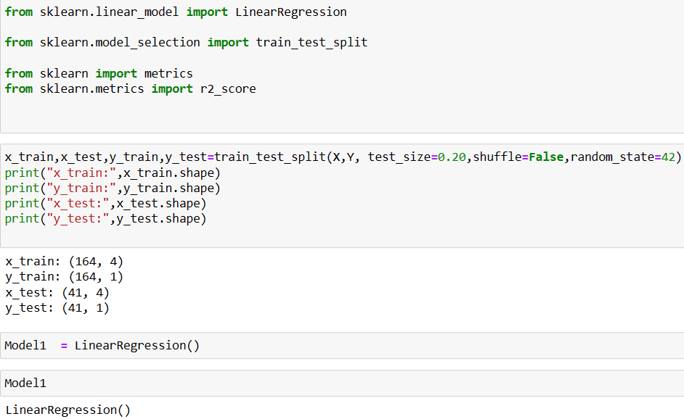
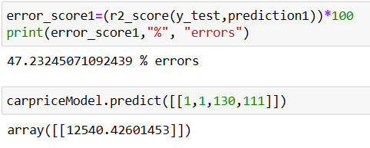
Importing The Model
Linear Regression
Linear regression analysis is used to predict the value of a variable based on the value of another variable. The variable you want to predict is called the dependent variable. The variable you are using to predict the other variable's value is called the independent variable

Slide 10
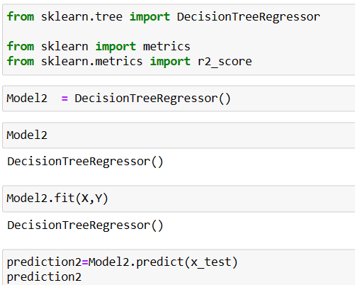
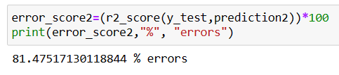
Importing The Model
Decision Tree Regression
Decision tree builds regression or classification models in the form of a tree structure. It breaks down a dataset into smaller and smaller subsets while at the same time an associated decision tree is incrementally developed. The final result is a tree with decision nodes and leaf nodes.

Slide 11
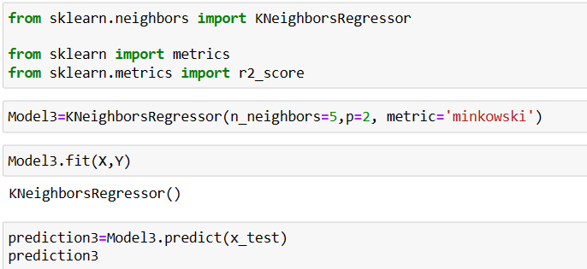

Importing The Model
Kneighbor Regressor
KNN regression is a non-parametric method that, in an intuitive manner, approximates the association between independent variables and the continuous outcome by averaging the observations in the same neighbourhood.

Slide 12
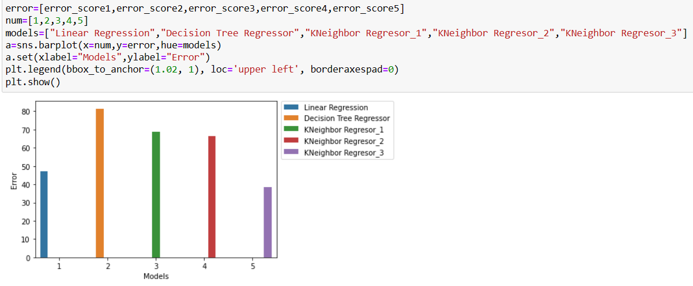
Comparison of different models

Slide 13
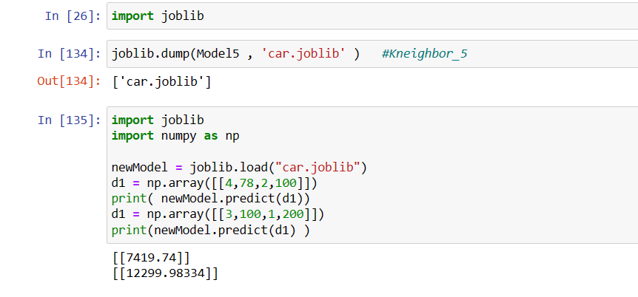
Joblib
Joblib is a Python library for running computationally intensive tasks in parallel. It provides a set of functions for performing operations in parallel on large data sets and for caching the results of computationally expensive functions

Slide 14
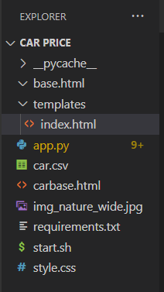
PRICE PREDICTION IN FLASK
FILES

Slide 15
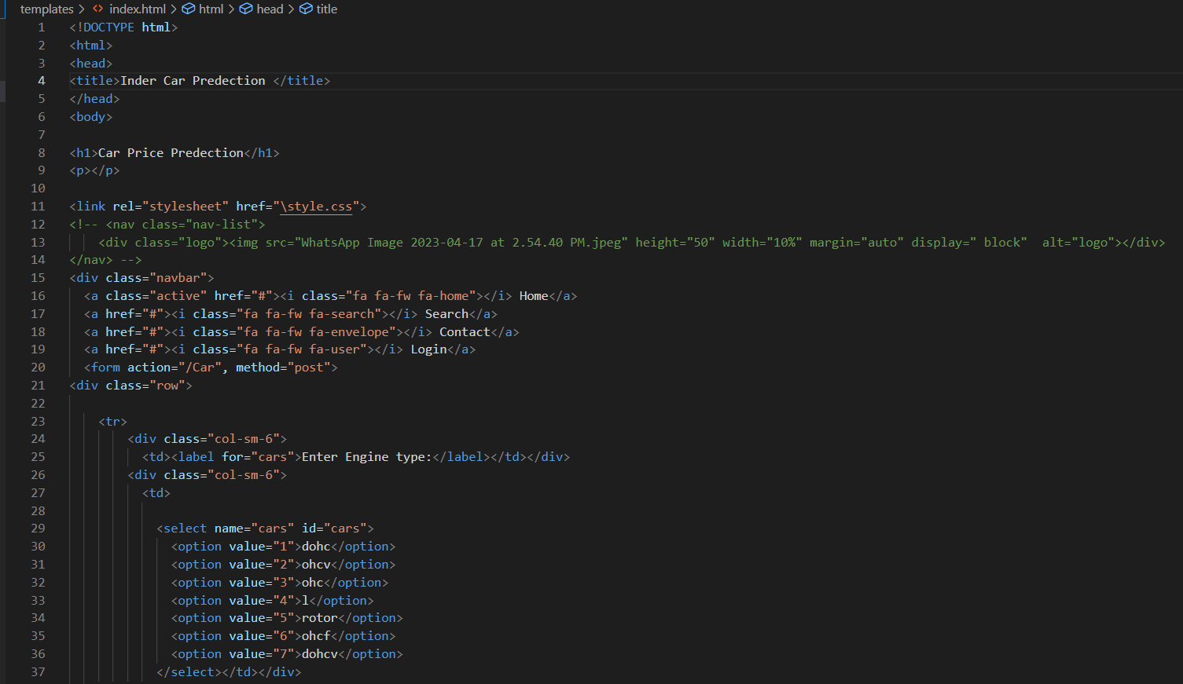
INDEX.HTML

Slide 16
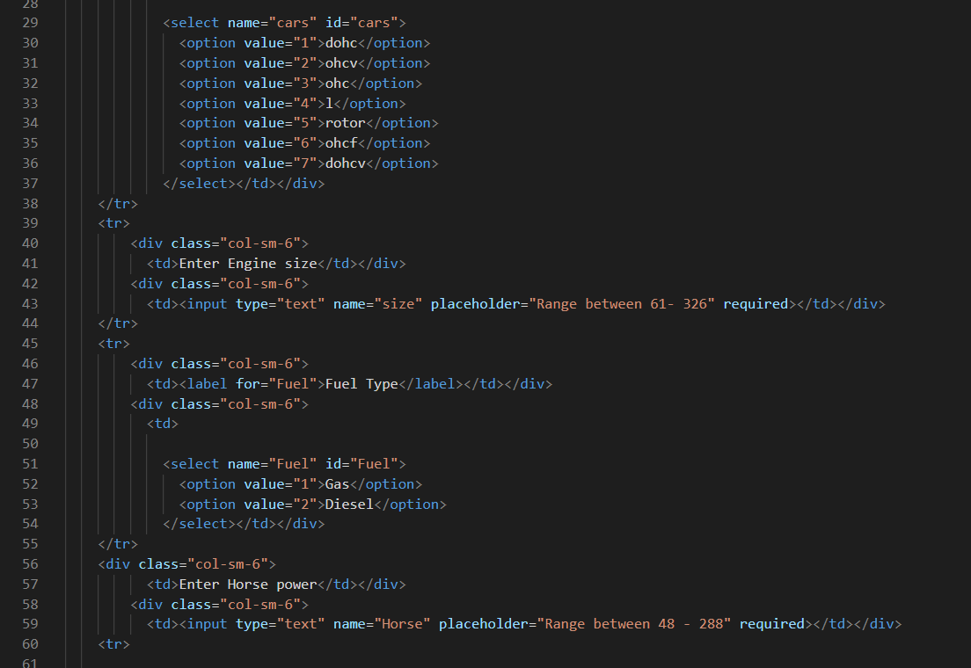
INDEX.HTML

Slide 17
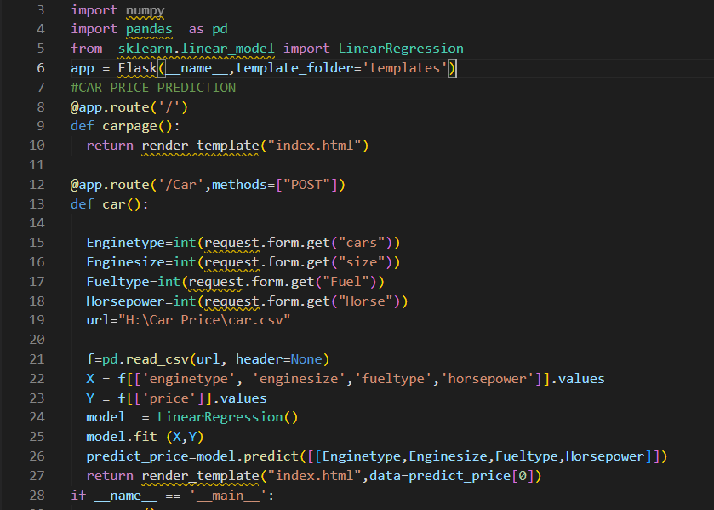
APP.PY

Slide 18
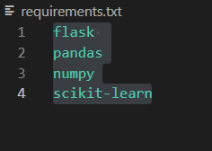

REQUIREMENT & START.SH

Slide 19
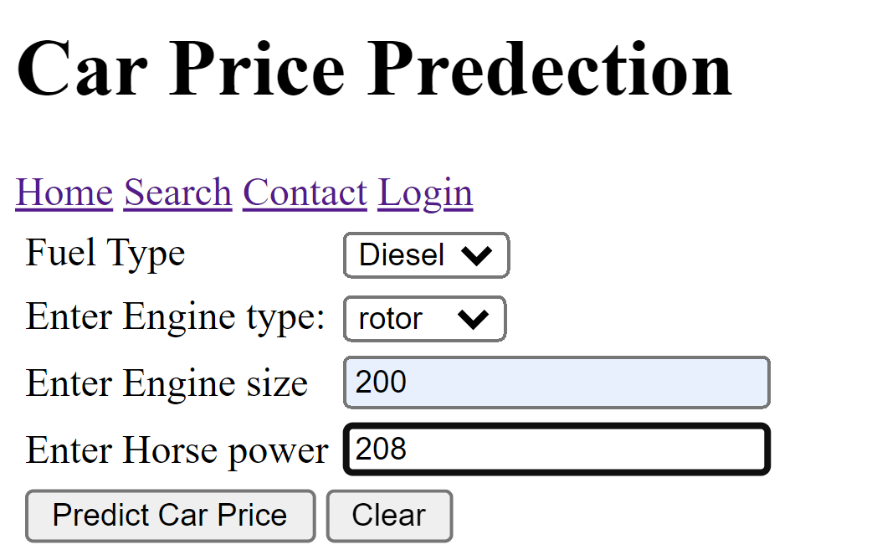
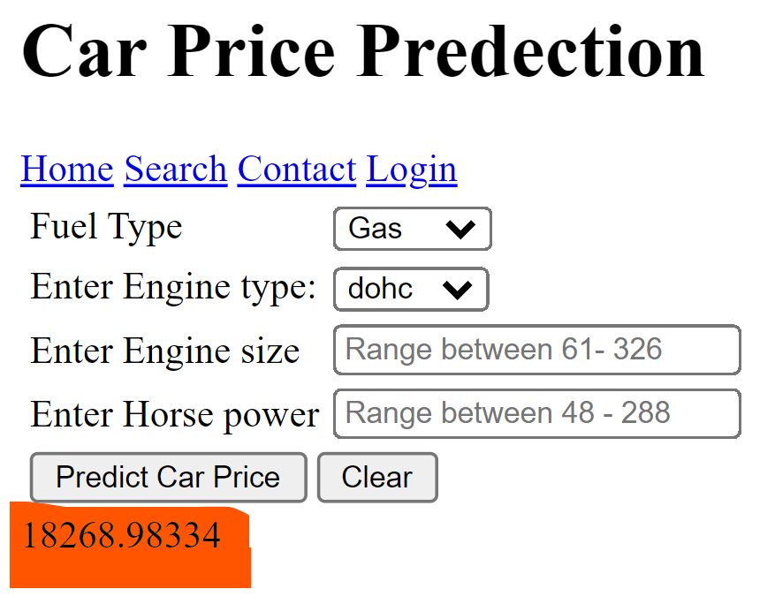
Flask Output

Slide 20
RESULT
THANKU
INDER DEV SINGH

